Slide 1
EQ – How do we add and subtract fractions with different denominator?
Add and Subtract Fractions: Different Denominator
Mrs Stretch
Year 7

Slide 2
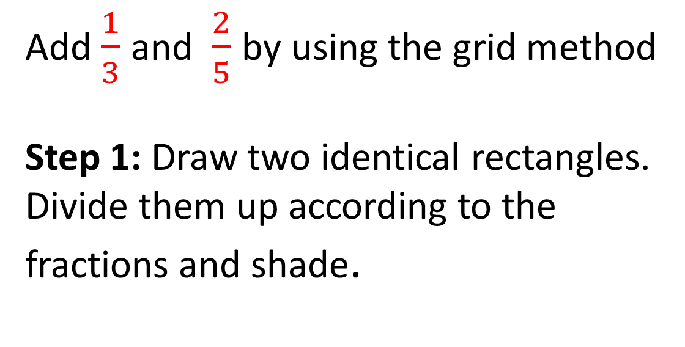
24
7
30
Add and Subtract Fractions: Differ Denominator
Date
EQ – How do we add and subtract fractions with the differ denominator?
Add $\frac{1}{3}$ and $\frac{2}{5}$ by using the grid method
Step 1: Draw two identical rectangles. Divide them up according to the fractions and shade.
Method 1
Grids

Slide 3
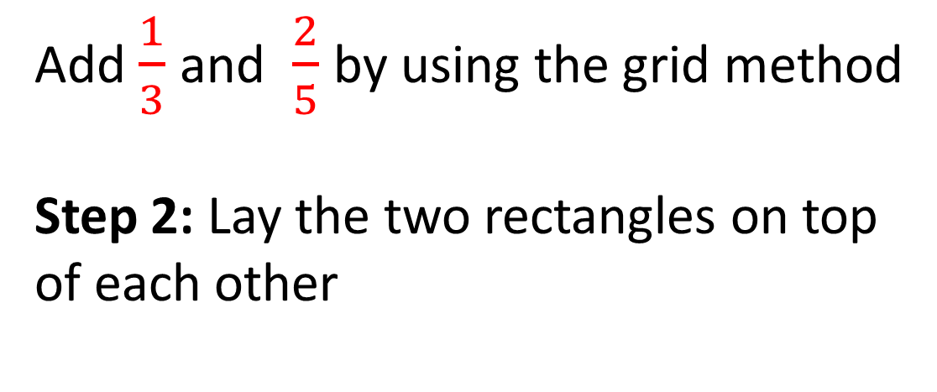
24
7
30
Add and Subtract Fractions: Differ Denominator
Date
EQ – How do we add and subtract fractions with the differ denominator?
Add $\frac{1}{3}$ and $\frac{2}{5}$ by using the grid method
Step 2: Lay the two rectangles on top of each other
Method 1
Grids

Slide 4
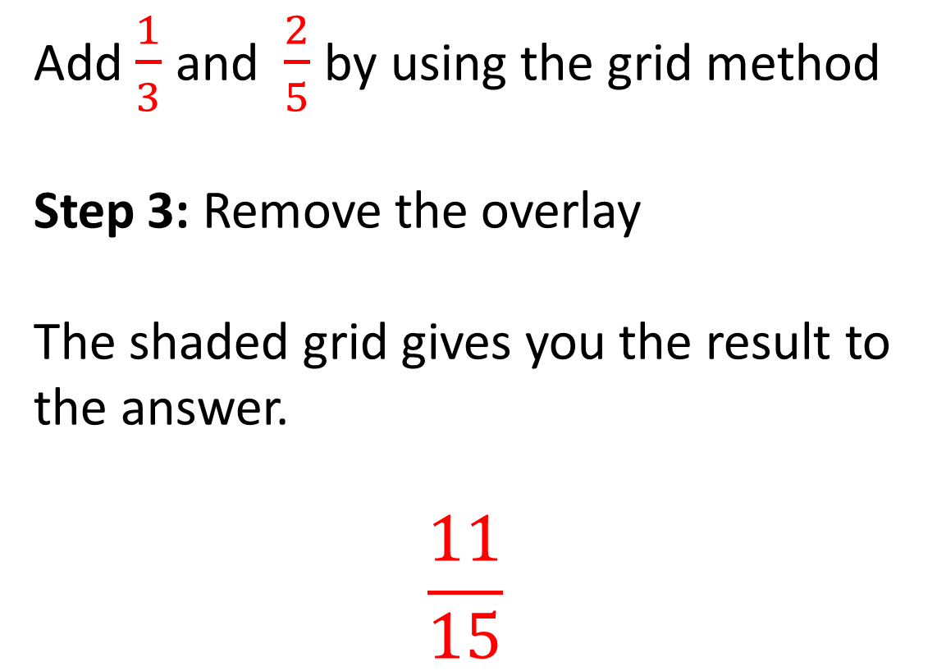
24
7
30
Add and Subtract Fractions: Differ Denominator
Date
EQ – How do we add and subtract fractions with the differ denominator?
Add $\frac{1}{3}$ and $\frac{2}{5}$ by using the grid method
Step 3: Remove the overlay
The shaded grid gives you the result to the answer.
$$\frac{11}{15}$$
Method 1
Grids

Slide 5
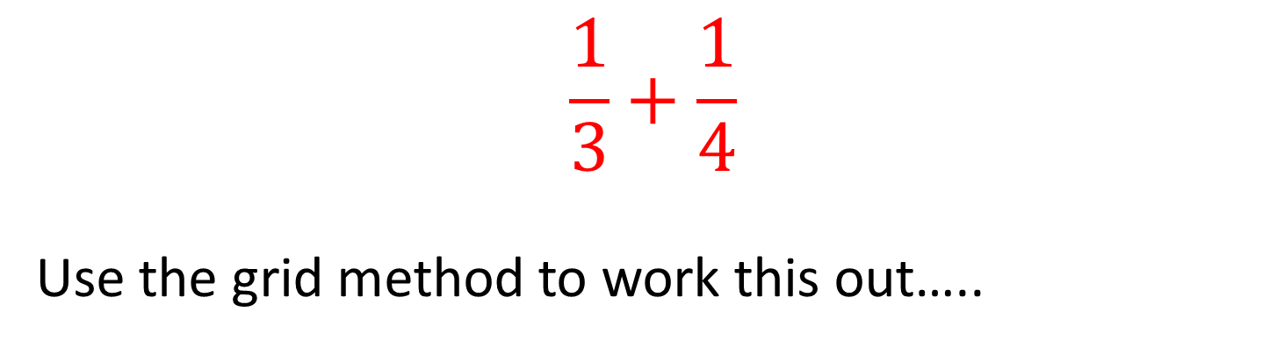
Practice
$$\frac{1}{3}+\frac{1}{4}$$
Use the grid method to work this out…..

Slide 6


Slide 7
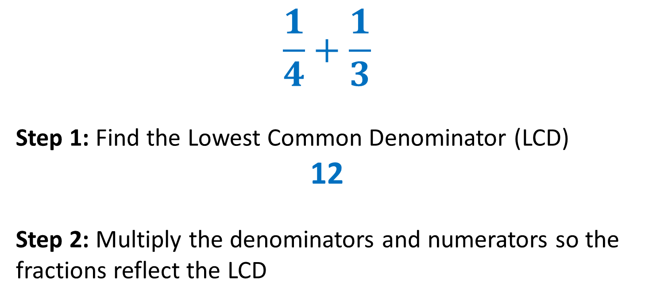
24
7
30
Add and Subtract Fractions: Differ Denominator
Date
EQ – How do we add and subtract fractions with the differ denominator?
Method 2
Finding the Lowest Common Denominator
$$\frac{1}{4}+\frac{1}{3}$$
Step 1: Find the Lowest Common Denominator (LCD)
12
Step 2: Multiply the denominators and numerators so the fractions reflect the LCD

Slide 8
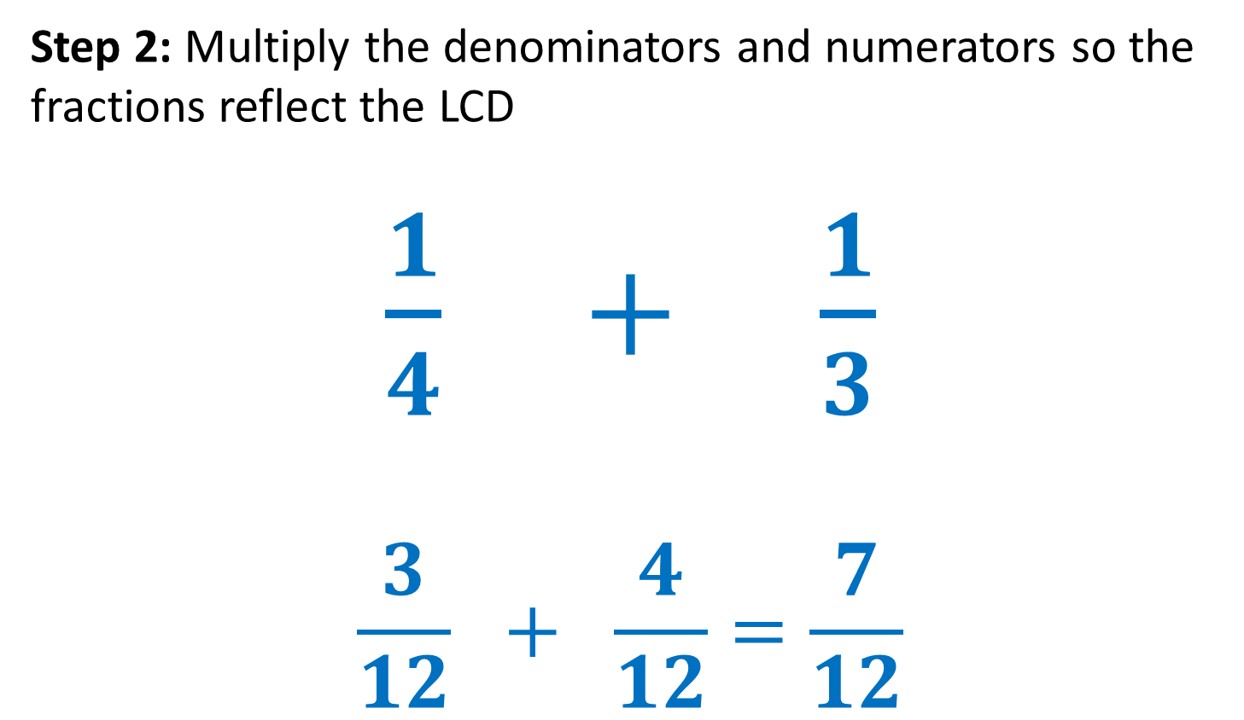
24
7
30
Add and Subtract Fractions: Differ Denominator
Date
EQ – How do we add and subtract fractions with the differ denominator?
Method 3
Finding the Lowest Common Denominator
Step 2: Multiply the denominators and numerators so the fractions reflect the LCD
$\frac{1}{4} + \frac{1}{3}$
$$\frac{3}{12} + \frac{4}{12}=\frac{7}{12}$$

Slide 9
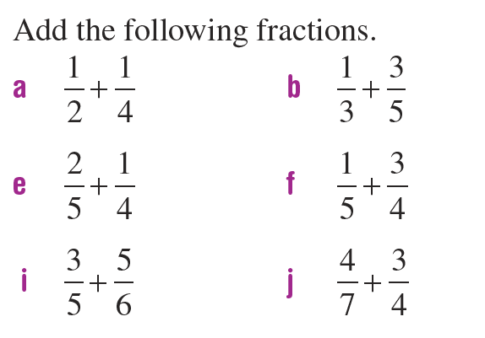
We do

Slide 10
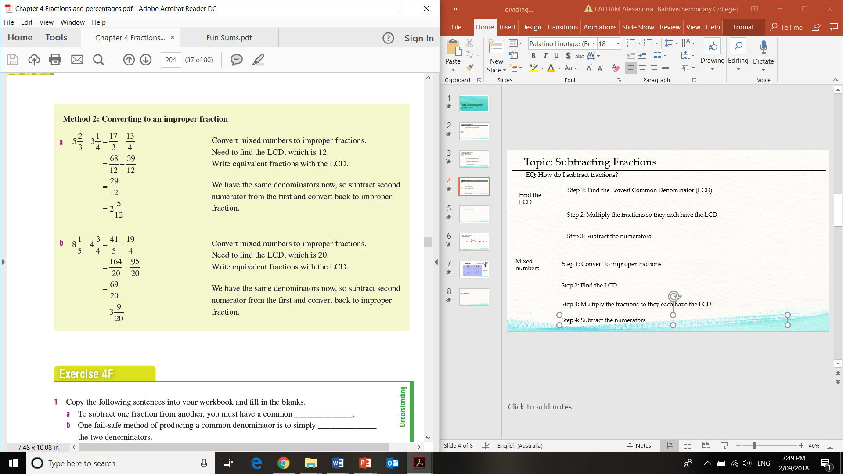
24
7
30
Add and Subtract Fractions: Differ Denominator
Date
EQ – How do we add and subtract fractions with the differ denominator?
Mixed Fractions
Step 1: Convert to improper fractions
Step 2: Find the LCD
12
Step 3: Multiply the fractions so they each have the LCD
Step 4: Subtract the numerators

Slide 11
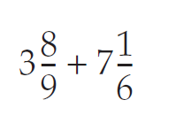
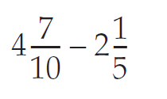
We do

Slide 12
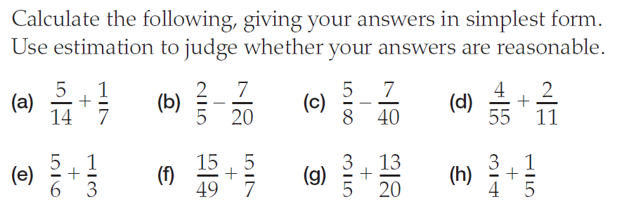
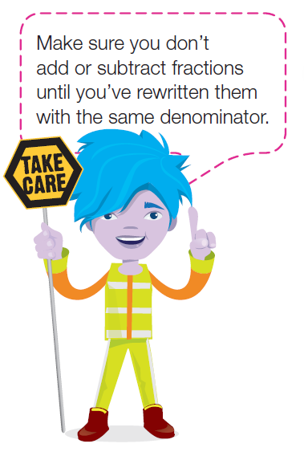
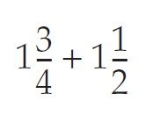
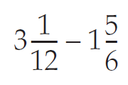
You do

